Slide 1

Fiduciary Duties of the Board of Directors of Remedy Analytics, Inc.
DeFi
Compliant Global Expansion
Privileged and Confidential Attorney–Client Communication
October 7, 2019

Slide 2
Overview
1
Cryptocurrency / Distributed Ledger Technology
2
Atomic Swaps/ Binary Contracts / Decentralized Exchanges
3
P2P Lending / Margin
4
Deposit / Staking / Interest-Bearing Accounts
5
Innovative Financial Instruments

Slide 3
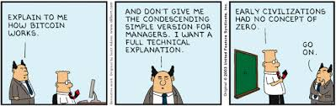
Cryptocurrency / Distributed Ledger Technology
Centralization: Is there an Administrator?
Regulated Activities: crypto-creator, custodian and exchanger

Slide 4
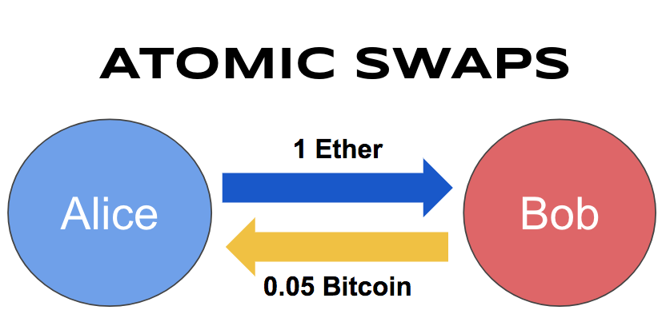
Atomic Swaps / Binary Contracts / Decentralized Exchanges
Peer-to-Peer Contracts Funded by Limited Collateral
Liquidity Problem with Decentralized Exchanges

Slide 5
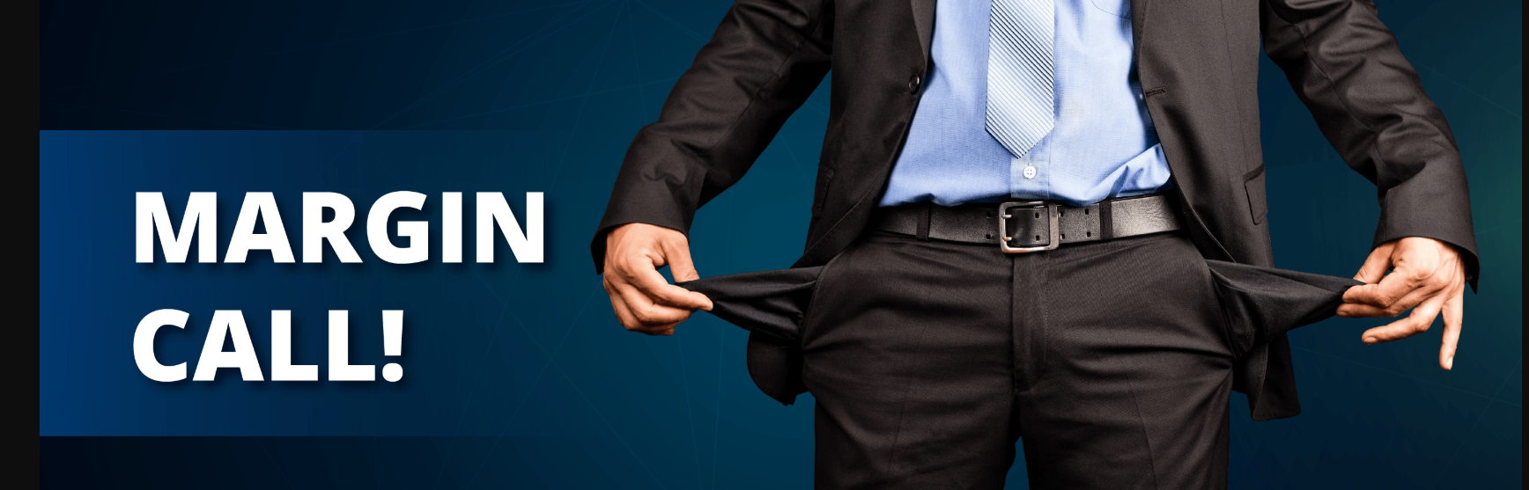
P2P Lending / Margin
Consumer vs. Business Lending
US Licensure Requirements

Slide 6
Deposit / Staking / Interest-Bearing Accounts
Deposits: Bank-License Traditionally Required
Money Transmission: Mandate Traditionally Required
Staking: Service or Lockup?
Interest-Bearing: Securities Exemptions?

Slide 7
Innovative Financial Instruments
Traditional Crypto: Ledger-entry Only
Stablecoins
Security Tokens
Debt Instruments

Slide 8
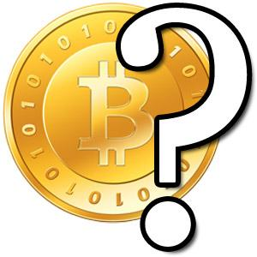
Questions

